Slide 1
RA 505 Robot Sensing and Vision Lecture 27
Dr. Rishikesh Kulkarni
Department of Electronics and Electrical Engineering
IIT Guwahati

Slide 2
Photoconversion characteristics
Quantum efficiency
Responsivity

Slide 3
Photoconversion characteristics
Dynamic range:
Signal-to-noise ratio

Slide 5
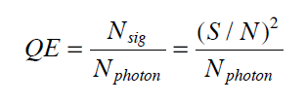
Photoconversion characteristics
Estimation of quantum efficiency
Estimation of conversion gain

Slide 6
Photoconversion characteristics
Estimation of full well capacity
Noise Equivalent Exposure : SNR = 1
Linearity
Crosstalk
Sensitivity and SNR
ratio of the output change to the input light change
volts/lux-sec, bits/lux-sec

Slide 7
Modulation transfer function

Slide 8
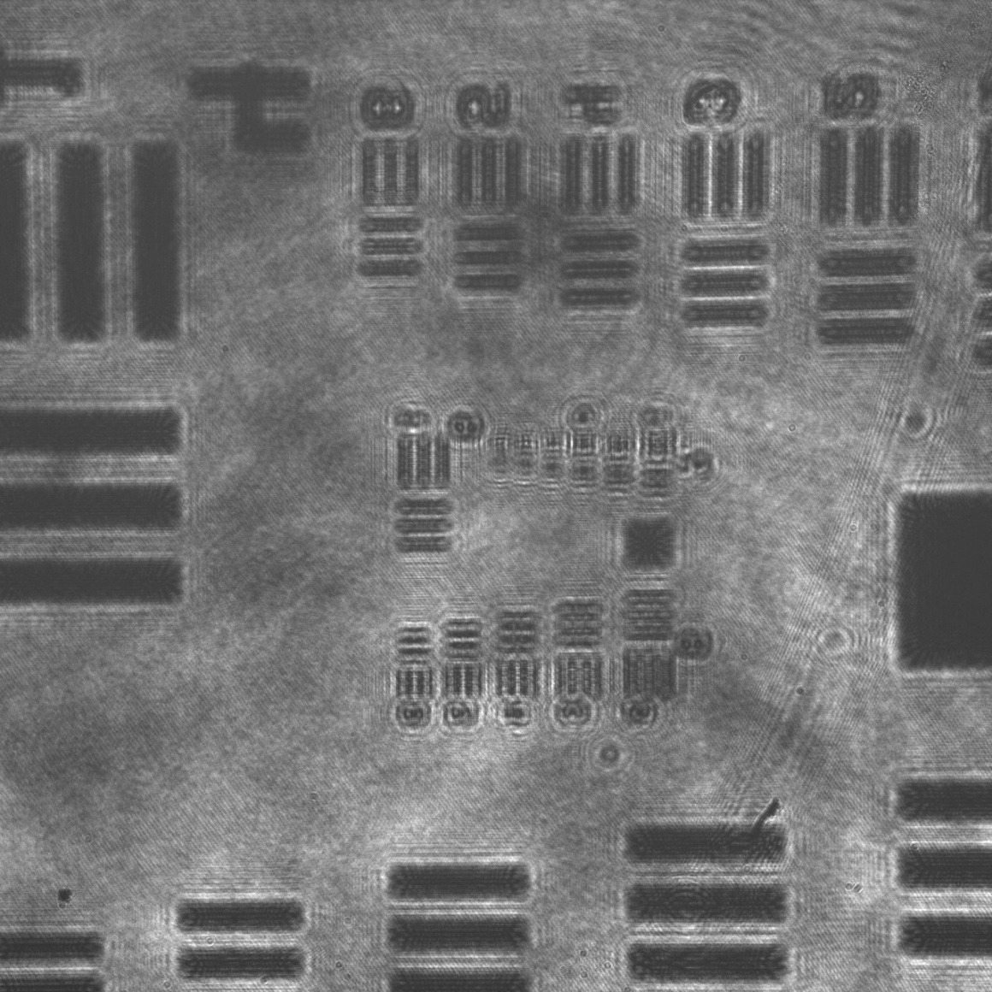
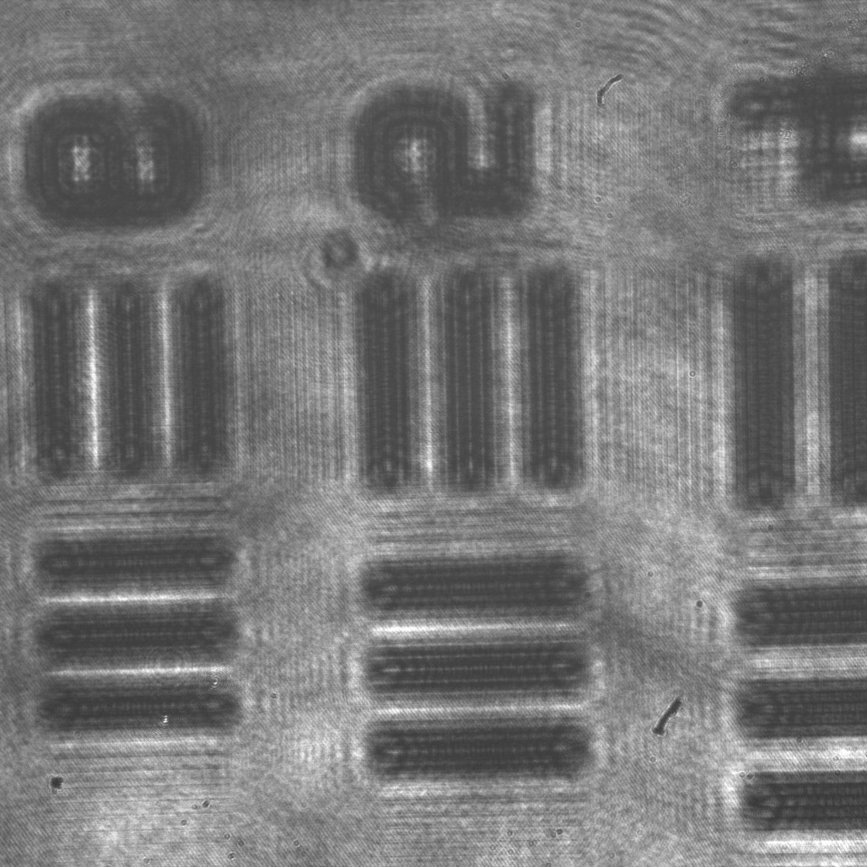
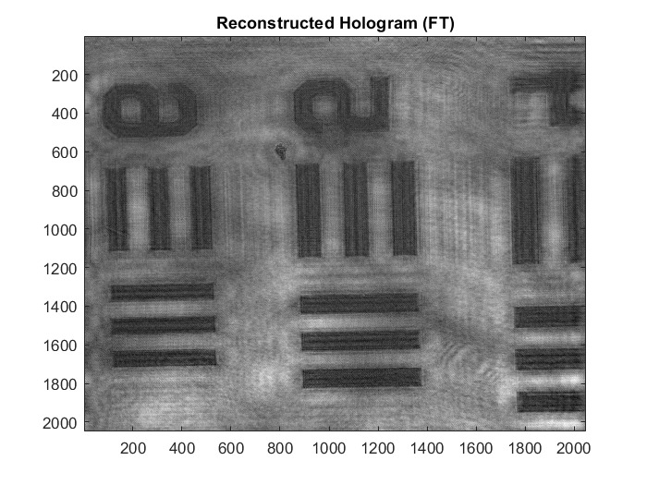
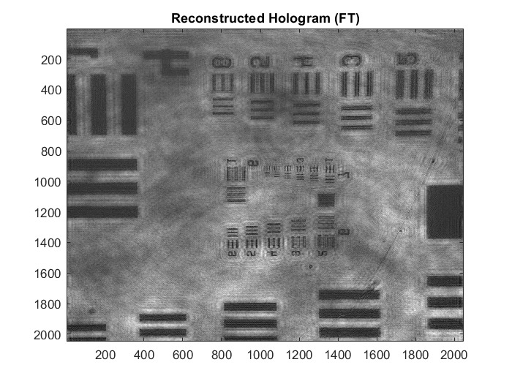

Slide 9
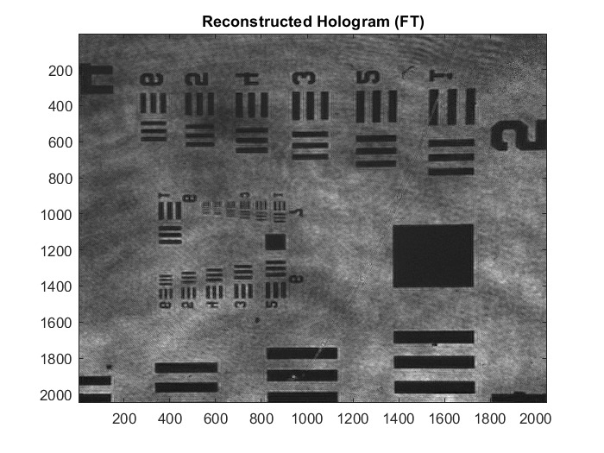

Slide 10
Optical black pixels and dummy pixels

Slide 11
Optical format and pixel size

